Slide 1
The economic and institutional infrastructure under-girding strong vocational education and training (VET) systems worldwide
Education-employment linkage
Return on investment for training companies
Continuous system improvement toward permeability

Slide 2
Education-employment linkage The best universal indicator we have for quality
Optimal linkage is an equilibrium of power between actors from the education system and employment systems.
Linkage
Optimal
Linkage
Employer engagement strategy:
Moving power in VET from mostly education to include employment.
Education formalization strategy:
Moving power in VET from mostly employment to include education.
Education
Power
Employment

Slide 3
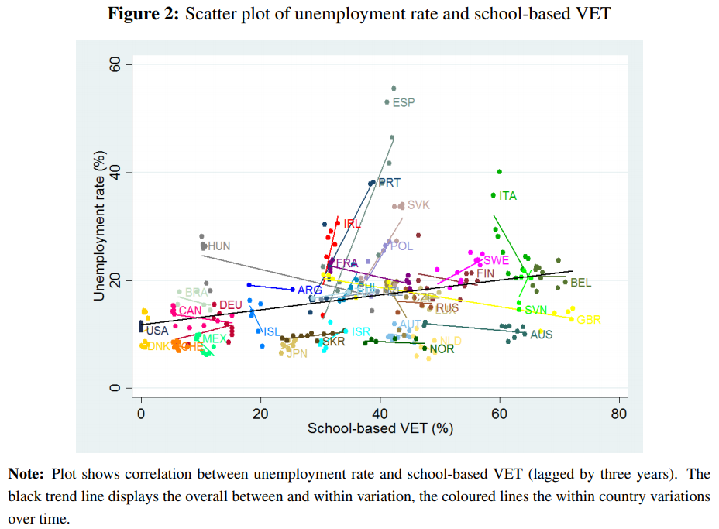
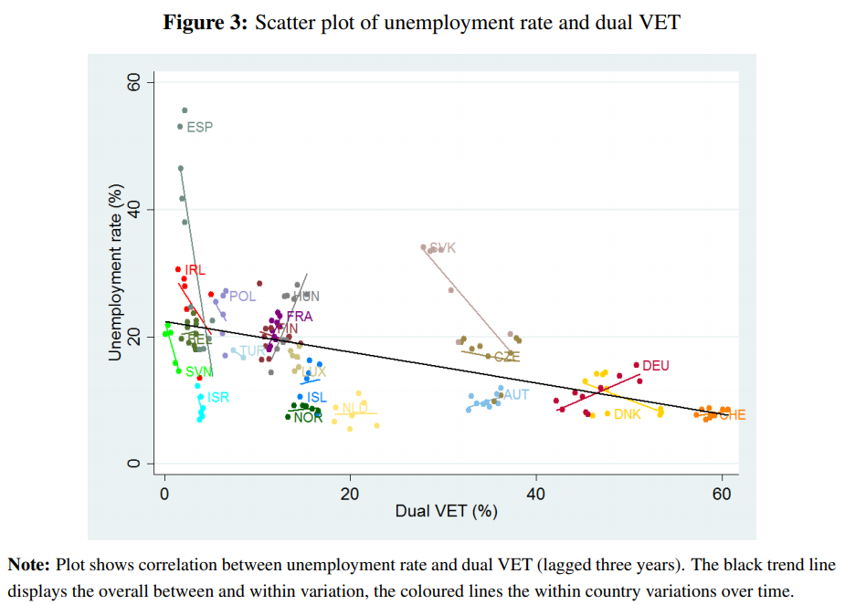
Education-employment linkage Example: School-based VET vs. dual VET (apprenticeship)
Source: Meet the Need (Bolli, Egg, Rageth, 2021)

Slide 4
Return on investment for training companies
Marginal product
Training costs
Marginal product
of participant
Post-
training
wage
Return Period
Training costs
Investment period
Unskilled
wage
Time
Before
program
Program
duration
After
program
Source: Own depiction based on Lerman (2014)
Notes:
Apprentice wage depends on e.g. unions
Cost Timing depends on financing of general education by government
Wage compression affected by e.g. labour market frictions, unions

Slide 5
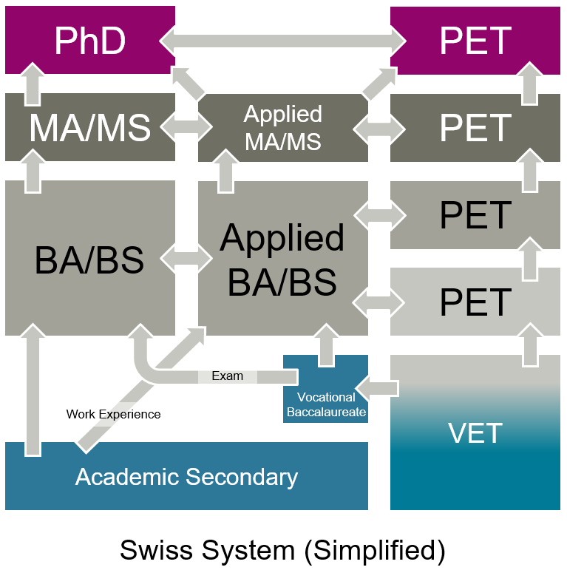
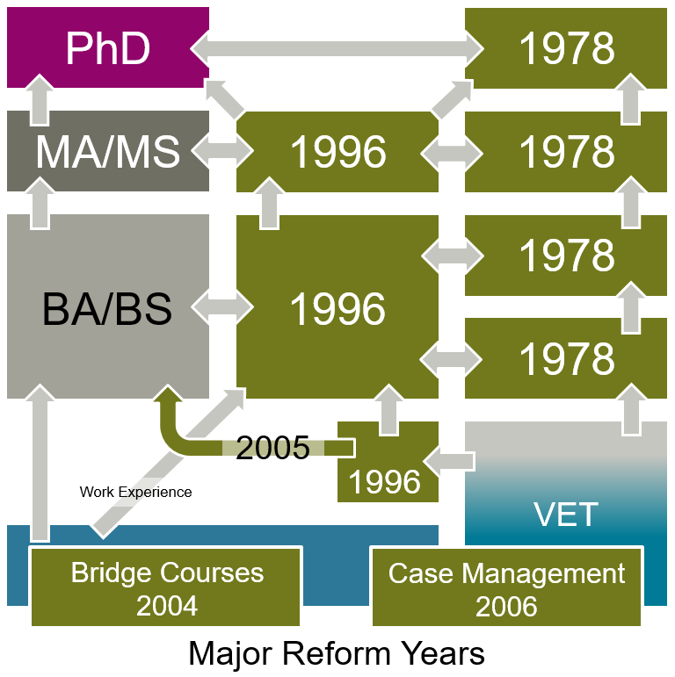
Continuous system improvement toward permeability
VET= Vocational Education and Training (Upper Secondary Level)
PET= Professional Education and Training (Tertiary Level)

