Slide 1


Your Partner
FOR EDUCATION, QUALIFICATION AND HR SERVICES

Slide 2
What Works: Lessons on (Post-) Secondary Vocational Education Worldwide
Global perspectives on innovative models of vocational education & training partnerships
Speaker: Marco Lietz, Head of International Projects at Biwe (https://www.biwe.de/our-profile)

Slide 3
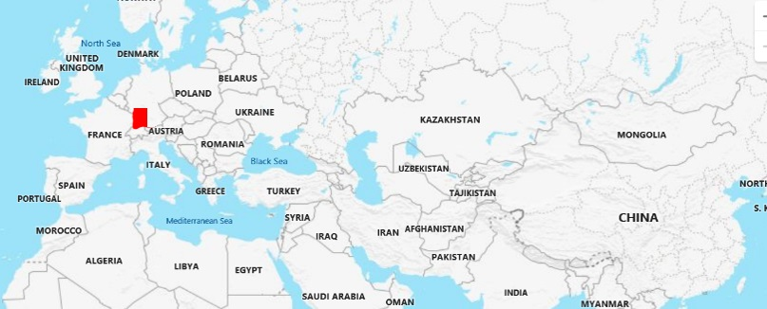
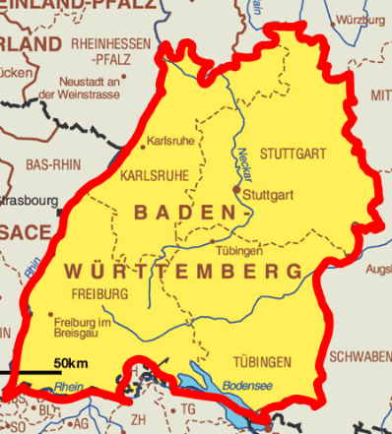
Best regards from Karlsruhe, Germany
Who is Bildungswerk der Baden-Württembergischen Wirtschaft (Biwe)?
We are the education and training organisation of employers from Germany's south-western state of Baden-Württemberg.
  Founded 1971
Situation today:
  700 employees
  >50 branches
  2 training centres
  66.000 persons qualified per year
  3.600 participating companies per year

Slide 4
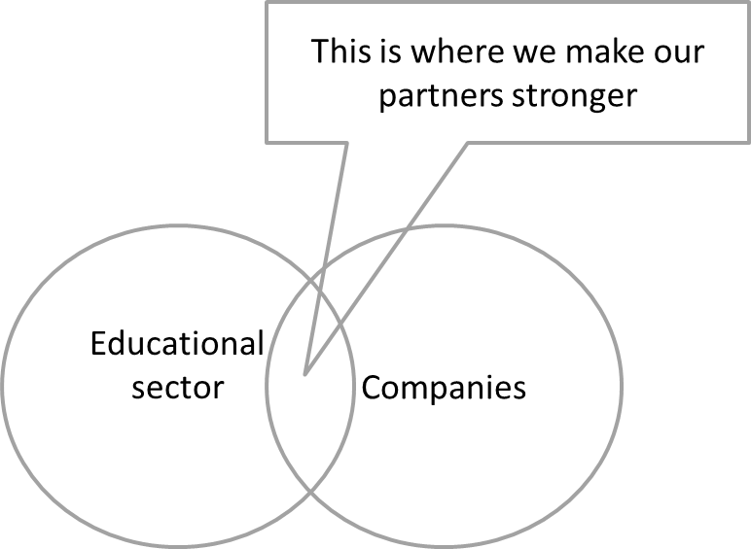
What many of my colleagues do

Slide 5
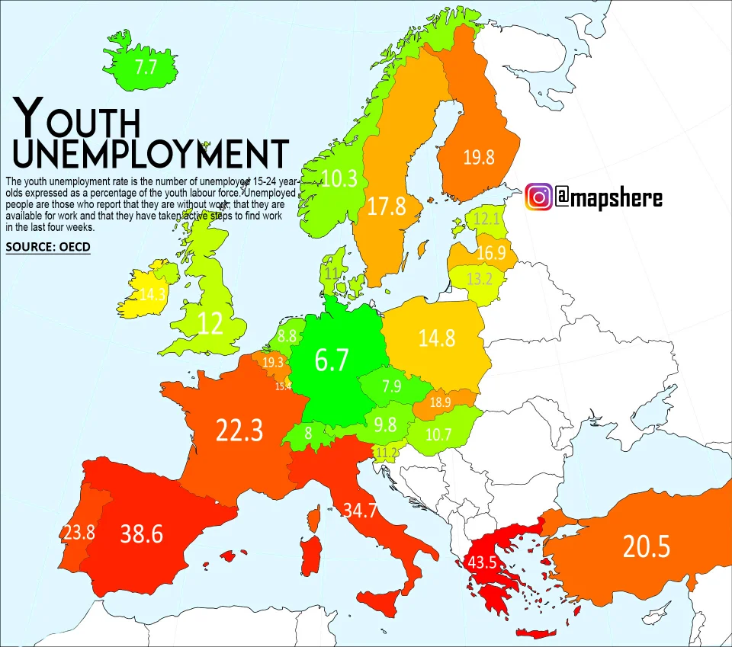
What is different in Central Europe?
Youth unemployment in the EU Age 15-25
Further data about Baden-Württemberg from 2019
EU No.1 in innovations
Unemployment rate: 3,2 %
Youth unemployment rate:
31% of the population has roots abroad → Integration works

Slide 6
This is what we are frequently asked about
Dual Vocational Education and Training
The in-company phase is not just an internship. There is a structured plan with suggested tasks and an evaluation.

Slide 7
Some aspects to consider when implementing DVET abroad
Experiences of the last decades from 4 continents
Implementation of dual structures - two questions that are frequently forgotten
Aspect | Comment
Analysis or adaption to the legal context | Is usually done
Development of in-company curriculum | Is usually done
Development of an agreement between the apprentice/student, the institute and the company | Is usually done
Training of in-company trainers | Is usually done
Recruitment of apprentices | Is usually done
Acquisition of companies – who does this? | Is frequently forgotten
Assurance of training quality when the apprentice/student is in the company – who does this? | Is frequently forgotten

Slide 8
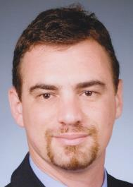
Thank you for your attention!
Contact
Marco Lietz
  Head of International Projects
  Bildungswerk der Baden-Württembergischen Wirtschaft e. V.
  Ebertstraße 41
  76135 Karlsruhe
  Germany
  Phone +49 (0)721 62687-14
  Mobile +49 (0)170 2291174
  E-Mail lietz.marco@biwe.de
  Website www.biwe.de

