Slide 1
Measuring Adult Skills in Developing Countries
Alexandria Valerio
avalerio@worldbank.org
September 21, 2021

Slide 2
3 Messages
1
2
3
STEP
Skills Measurement
Key Findings
Lessons Learned

Slide 3
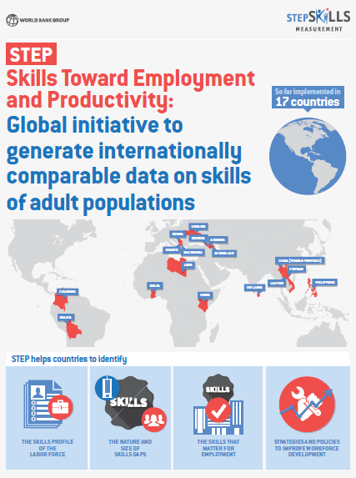
Limited information
Proficiency of adults' skills (stock)
Extent of skills use, and intensity of skills use at the workplace and in daily life
Payoffs of skills beyond years of education completed
Role of different types skills —cognitive, socioemotional, job specific—on employability and labor market trajectory
Premium placed comparable data across countries—STEP collaborated with PIAAC-OECD
Household surveys were paired with employer surveys

Slide 4
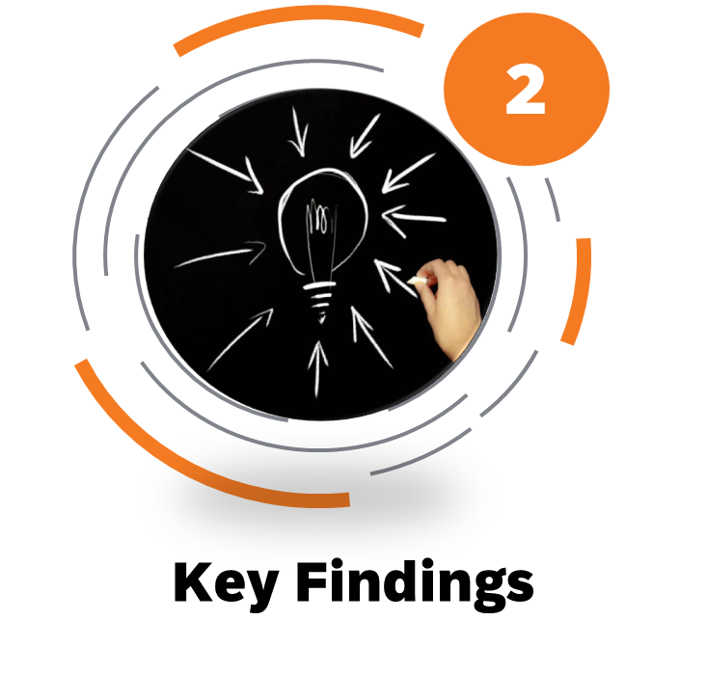
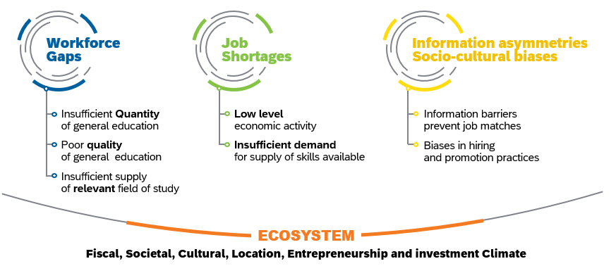
Unpacking “mismatch” in the labor market

Slide 5
Granular skills data supports policy decisions in developing countries in ways that were not possible before; helping in tailoring solutions based on actual skills profiles not just schooling
Schooling is a helpful proxy for skills, but not a very precise one—leaves a lot of variation unexplained
Substantial increase in school enrollment and attainment, but narrow and uneven improvements in literacy skills
Too many young people exit school early without robust literacy skills—on average, only 35% of primary entrants' complete upper secondary education; in SSA fewer than 25%
“Early skills gaps” become “long-lasting skills gaps” with adverse implications throughout life—unless skills deficits are remediated, low literacy is not transitional, it is a destination
More than half of adults in Bolivia, Ghana and Kenya score below level 2 literacy; a sizable share of adults are not “job ready” or “training ready”
The number of “schooling years” required to reach Level 2 literacy ranges from 9 years in Armenia, Finland, and Vietnam to 16 years in Bolivia, Ghana and Kenya
New insights on correlations between workers’ literacy proficiency and skills use at work, skills use and worker productivity, and “match” rates between worker and job-required education

Slide 6
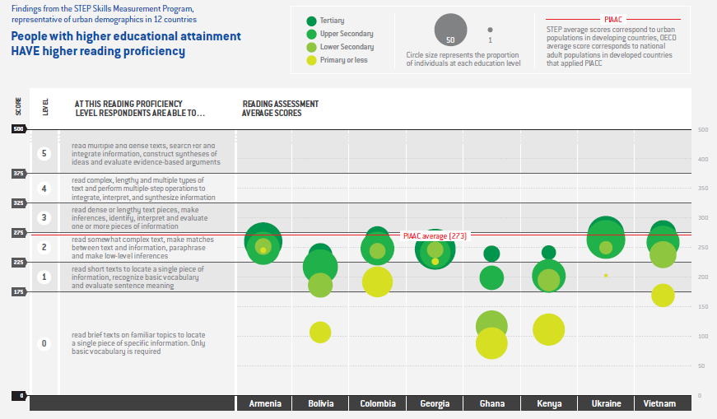
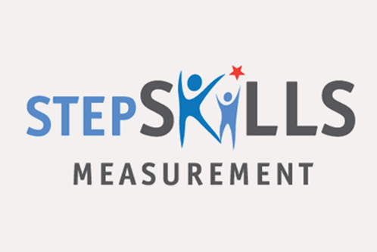
Level
At this literacy proficiency level respondents can:
Literacy assessment average scores

Slide 7
STEP surveys are intended to shine light on the size and magnitude of skills deficits in the population; however, ideally, they should be paired with analyses on institutional policies, training provision practices, and overall job growth and innovation ecosystem
Having a shared definition of “literacy” and comparative measurement approaches is very powerful in discussions with policy makers to inform skills development policy, strategy and investment choices
Measuring adult skills is complex; it requires enough funding, time, patience, and expertise at all stages
Global comparative standards are often very different from the conventional standards used in most countries for household surveys
Training, training, and more training is needed to safeguard data quality and overall survey integrity
Measuring socioemotional skills remains an unconquered frontier
Making data files and supporting materials available online stimulates independent research; though research uptake remains relatively low, especially in developing countries

Slide 8
Thank you
https://microdata.worldbank.org/index.php/catalog/step/about
Education, Skills, and Labor Market Outcomes : Results from Large-Scale Adult Skills Surveys in Urban Areas in 12 Countries

