Slide 1
PIAAC: a brief introduction
William Thorn, Senior Analyst , OECD

Slide 2
Purpose
Briefly describe PIAAC, and
present some results.

Slide 3
PIAAC: the basics
PIAAC – the Programme for the International Assessment of Adult competencies
Household-based study that assesses literacy, numeracy and problem solving skills of adults
Target population: 16-65 year olds
1st cycle of the study has involved three rounds of data collection
2011-12 (24 countries)
2014-15 (9 countries)
2017-18 (6 countries)
2nd Cycle in preparation – data collection in 2022-23

Slide 4
Skills Assessed
accessing, using and reasoning critically with mathematical content, information and ideas represented in multiple ways in order to engage in and manage the mathematical demands of a range of situations in adult life.
Literacy
accessing, using and reasoning critically with mathematical content, information and ideas represented in multiple ways in order to engage in and manage the mathematical demands of a range of situations in adult life.
Numeracy
Adaptive Problem Solving
the capacity to achieve one’s goals in a dynamic situation, in which a method for solution is not immediately available. It requires engaging in cognitive and metacognitive processes to define the problem, search for information, and apply a solution in a variety of information environments and contexts
Notes:
We chose to focus the survey on the ability of people to understand, use and engage with written information;
On their ability to use, interpret and communicate mathematical ideas
And their capacity to use digital technologies and resources to get and evaluate knowledge.

Slide 5
The background questionnaire
Section | Content
A | Background Information
B | Education and Training
C | Labour Force status and work history
D | Characteristics of current job
E | Characteristics of last job (if unemployed and worked in last 5 years)
F | Literacy, Numeracy and ICT Practices at Work
G | Literacy, Numeracy and ICT Practices in Everyday Life
H | Working Environment
I | About Yourself (social trust, cultural capital, family situation when young , parental background)
J | Personality traits (the Big 5)

Slide 6
International assessments of adult literacy
Study | Date(s) of data collection | No. of Countries | Skills assessed
IALS | 1994, 1996, 1998 | 21 | Literacy
ALL | 2003, 2007/08 | 11 | Literacy, Numeracy, Problem Solving
PIAAC (Cycle 1) | 2011-12, 2014, 2016 | 39 | Literacy, Numeracy, Problem Solving in Technology-Rich Environments
PIAAC (Cycle 2) | 2022-23 | 33 | Literacy, Numeracy, Adaptive Problem Solving
Comparable measures over time:
Literacy: from 1994 to 2022/23,
Numeracy: from 2007 to 2022/23

Slide 7
Some Results

Slide 8
Literacy proficiency of adults
Notes:
Proficiency is measured on a 500 point scale.
Countries in Round 3 of PIAAC are presented in a darker tone.

Slide 9
Literacy and socio-demographic
characteristics: a summary – OECD average
Gender
Parents’ education
Educational
Attainment
Age
Immigrant background
Score points

Slide 10
Skill proficiency and age: OECD

Slide 11
Numeracy and positive outcomes
Percentage-point change associated with a change of one standard deviation in proficiency in numeracy (OECD average)
Notes:
Notes:
High levels of trust are defined as when respondents agreed with the statement: : "There are only a few people you can trust completely".
High levels of political efficacy are defined as when respondents agreed with the statement: "People like me have any say about what the government does".
High levels of health are defined as when respondents answers ‘good’, ‘very good’ or ‘excellent’ to the question ‘In general, would you say your health is… ‘

Slide 12
Research using PIAAC data
Wide range of topics and themes explored relating to :
Labour market participation and outcomes, skill match/mismatch, inequality, development of skills, transitions through education and into work, schooling, lifelong learning, health outcomes, skills development, immigrants, automation, adult learning, methodological questions….

Slide 13
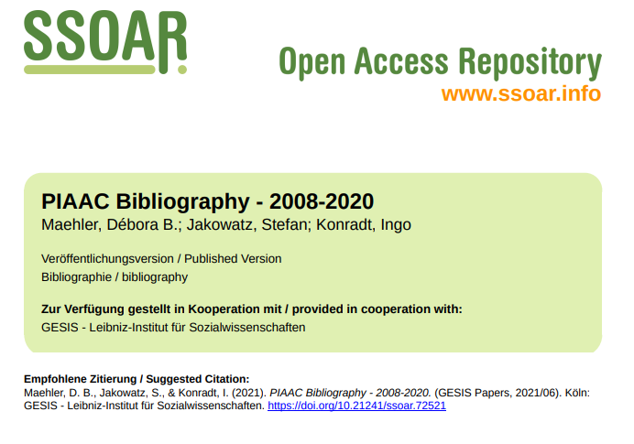
Where to start…
Reports and other publications: https://www.oecd.org/skills/piaac/publications/
PIAAC Bibliography

Slide 14
Find Out More About PIAAC at:
www.oecd.org/site/piaac
All national and international publications
The complete micro-level database
Email william.thorn@oecd.org
Thank you

