Slide 1
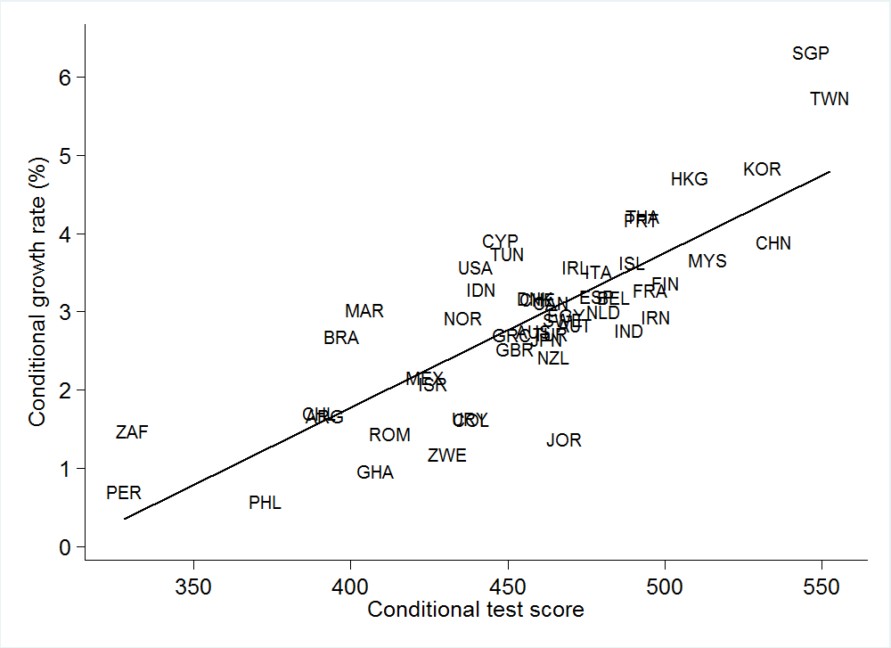
Cognitive Skills and Economic Growth, 1960-2000
Source: Hanushek and Woessmann (2015)

Slide 2
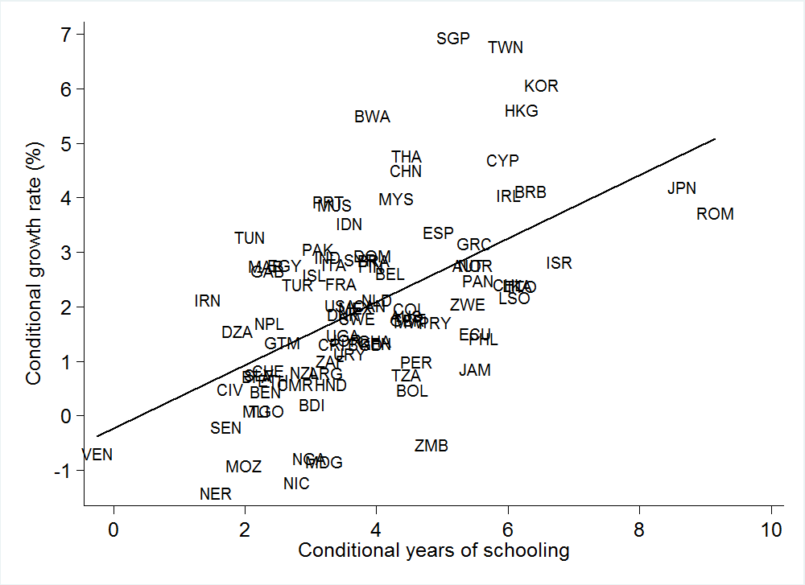
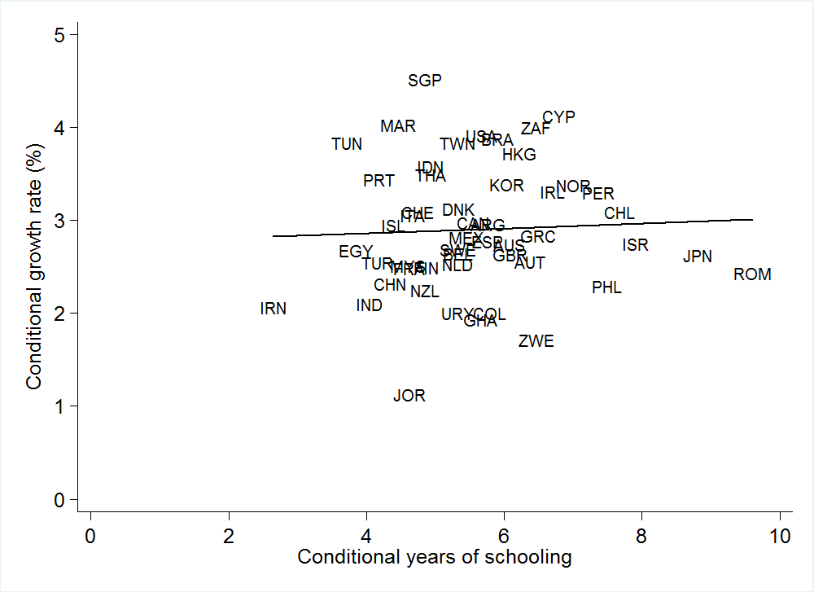
Years of Schooling and Economic Growth
with cognitive skills
without cognitive skills
Source: Hanushek and Woessmann (2015)

Slide 3
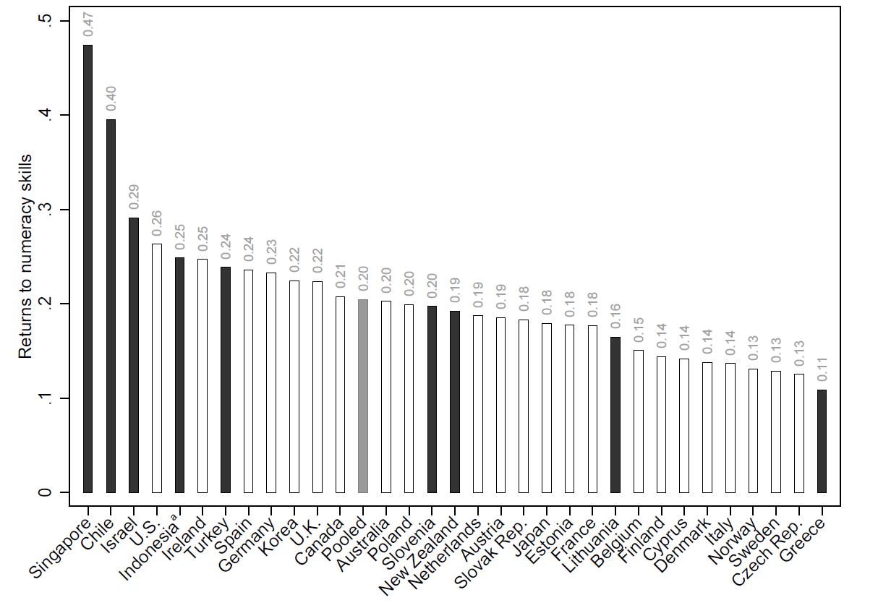
Labor Market Returns to PIAAC Skills
Scource: Hanushek, Schwerdt, Wiederhold und Woessmann (2017)

Slide 4
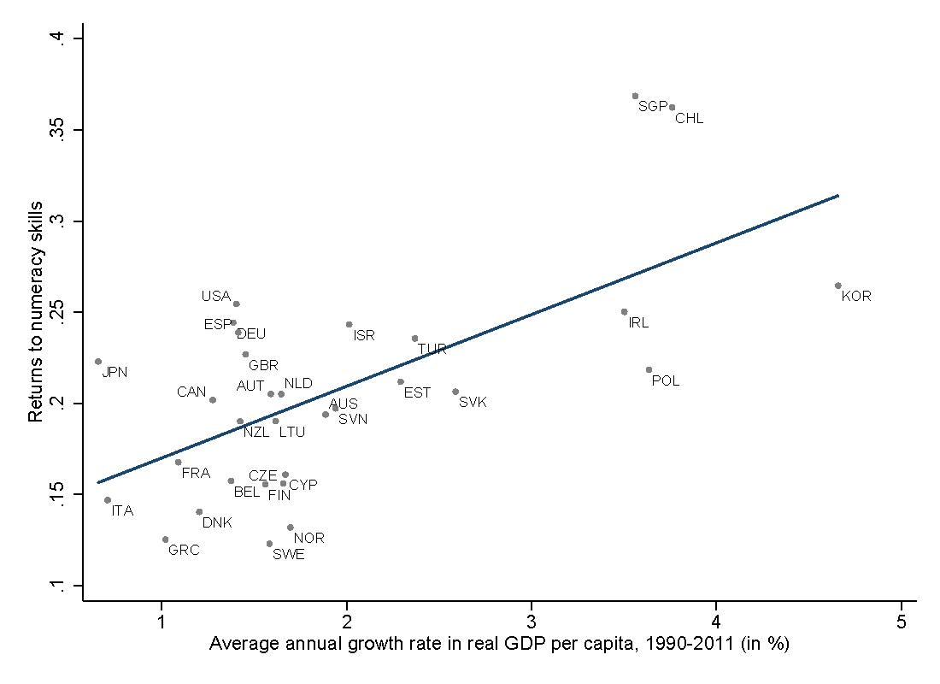
Returns to Skills and Economic Growth
Source: Hanushek, Schwerdt, Wiederhold und Woessmann (2017)

Slide 5
Child Skills and Parent Skills
Source: Hanushek, Jacobs, Schwerdt, van der Velden, Vermeulen and Wiederhold (2021)

Slide 6
Child and Parent Skill Differences
Source: Hanushek, Jacobs, Schwerdt, van der Velden, Vermeulen and Wiederhold (2021)

