Slide 1
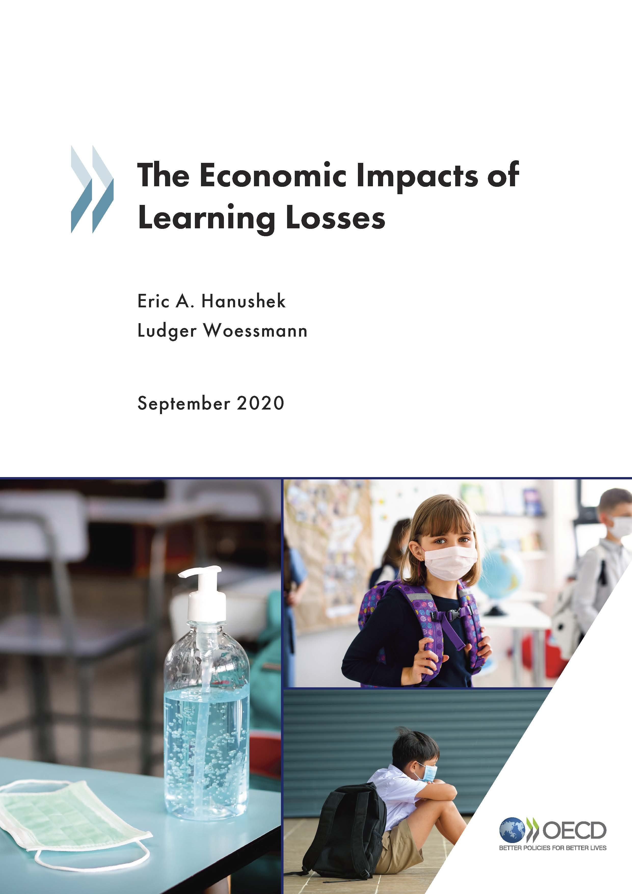
The Economic Impacts of Learning Losses
Eric A. Hanushek (Hoover Institution, Stanford U)
Ludger Woessmann (ifo Institute, U Munich)

Slide 2
Lost learning during times of closed schools
Universal closures imply significant learning losses
Most attention focused on logistics of re-opening
Full extent of harm not yet known
Provide “best case” estimates of losses

Slide 3
The Economic Impacts of Learning Losses
Eric A. Hanushek (Hoover Institution, Stanford U)
Ludger Woessmann (ifo Institute, U Munich)

Slide 4
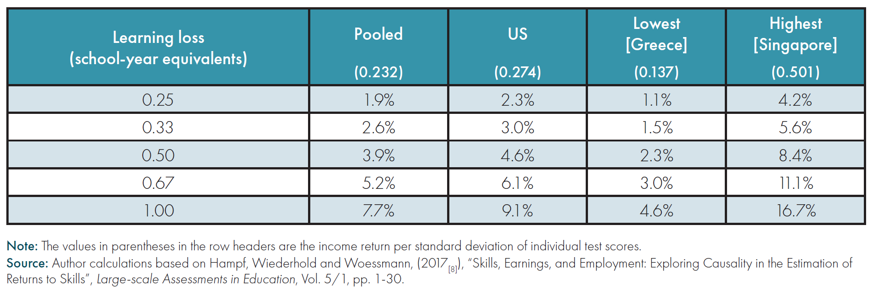
Lost individual income due to Corona-induced learning loss

Slide 5
Long-run loss in GDP due to Corona-induced learning loss

Slide 6
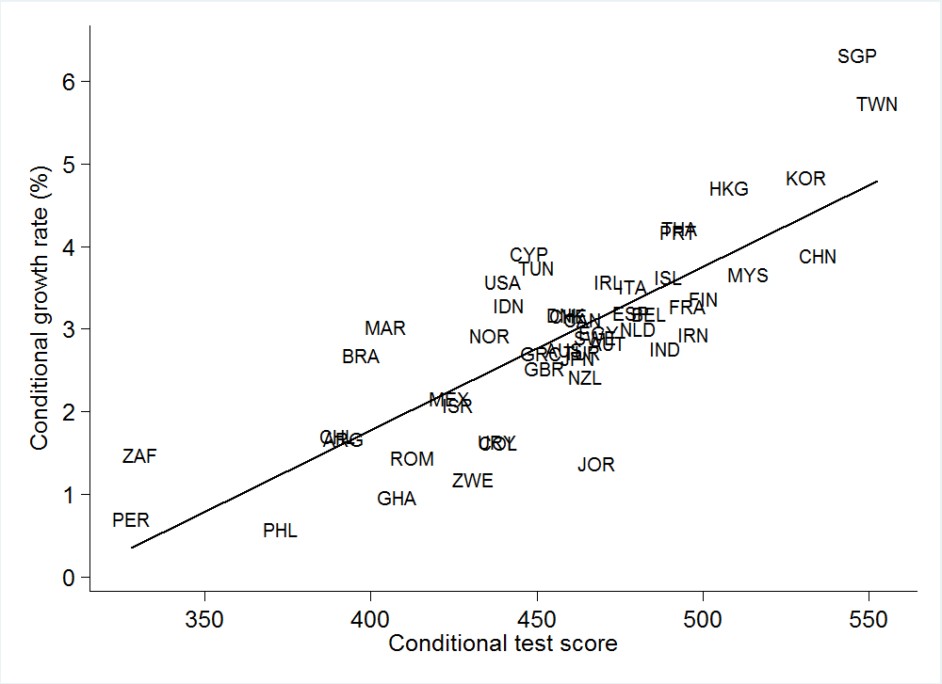
Knowledge Capital and Economic Growth, 1960-2000
Source: Hanushek and Woessmann (2015)

Slide 7
Present value of lost GDP due to Corona-induced learning loss for G20 nations

Slide 8
Making up for learning losses
Return to 2019 will not erase losses
Already facing reduced information
Not inevitable – countries have improved
Specific options building on circumstances
  More effectively employ teachers and personnel
  Individualize instruction

Slide 9
http://www.oecd.org/education/The-economic-impacts-of-coronavirus-covid-19-learning-losses.pdf

