Slide 1
Online Support for Deliberate Practice: Better Learning of the Fundamental Skills You Don’t Know You Know!
Ken Koedinger
Hillman Professor of Computer Science
Departments of Human-Computer Interaction & Psychology
Carnegie Mellon University
Yes and …
Notes:
Highlight some points from Heidi & Barbara’s great talks, particularly the complexity, need for an iterative process.
Elaborate on an aspect of learning that is not particularly emphasized in HPL2.

Slide 2
Learning & Education …
… are complex! As Barbara said
On many dimensions
One of those is instruction
How many different ways to teach are there?

Slide 3
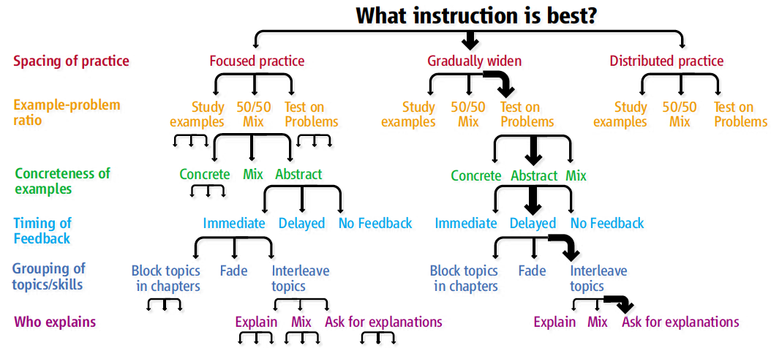
Instructional design space is vast
>200 trillion options
Koedinger, Booth, Klahr (2013). Instructional Complexity and the Science to Constrain It. Science.
Notes:
Different goals => different ideal solutions

Slide 4
No one size fits all choice!

Slide 5
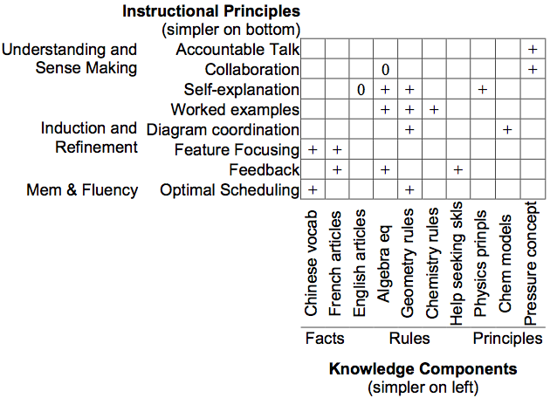
Knowledge-Learning-Instruction (KLI) Framework
-
-
+ +
-
+ +
+
+ +
+
+
1. Ideal instruction depends on knowledge goals
2. Because different learning processes are at work
Koedinger, Corbett, & Perfetti (2012). The Knowledge-Learning-Instruction (KLI) framework: Bridging the science-practice chasm to enhance robust student learning. Cognitive Science.
Facts Skills Principles
Notes:
A key goal of the KLI framework is as tool to generate novel hypotheses. One of them is the “knowledge dependency” hypothesis: Effectiveness of instructional methods depends on kinds of knowledge of knowledge to be learned (the cognitive nature of the learning goals), particularly whether they are facts to remember, skills to induce, or principles to understand. This hypothesis is in contrast to plausible competing hypotheses: 1) instructional principles are domain general, 2) instructional principles are dependent on domain characteristics (even more specific than the kinds of KCs), or 3) dependent something on features.

Slide 6
KLI Framework Reduces to ~3 options
Instructional recommendations for improving:
Memory of facts
Induction of skills/representations
Understanding of principles

Slide 7
Explicit Learning Bias
Flat part of the earth (what we see)
Explicit verbal learning:
Memory of facts
Sense-making of principles
Round part (what’s there)
Implicit non-verbal learning
Induction of representations & skills
Lots in HPL2
Not so much!

Slide 8
A focus on fundamental skills reduces to ~1 options
Lots of kinds of skills
Core academics: reading, writing, math
STEM Skills: computational thinking, argumentation, scientific thinking
Collaboration, social soft skills, civil discourse
Self-regulatory, emotional skills
Show me something that’s not a skill,
And I’ll show you something you can’t do!

Slide 9
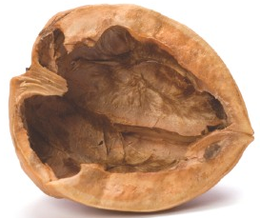
The “Best” in a Nutshell
Good learning-by-doing instruction requires
repeated practice on well-tailored tasks in varied contexts with explanatory feedback and as-needed instruction.

Slide 10
To learn X, one must do X
Generally true
the brain takes convincing!
whether you do it in conversation, on paper, or online
whether alone, with a tutor, with friends
Research evidence
Even renowned experts require years of practice
Summer slide: Academic experiences in life matter
Learning curves: Each opportunity => 2.5% increase

Slide 11
More Opportunities => More Learning
Topics mastered
Hours on Tutor
Notes:
Let us put these results into perspective for low performing students. Even among classes with reasonably high average use (>20 hours of time on tutor), we find many students with quite
low use. 20% of these students (in classes where the tutor is reasonably available), that’s 2100 students in this dataset, spend less than 15 hours (average of 7.5 hours) on the tutor over the
whole school year and complete an average of 10 sections. In contrast, students in the top 20% of usage are all putting in more than 57 hours (average of 85 hours) and complete an average of 82
sections. If one is willing to accept this online performance metric (sections completed) as a reasonable measure of student achievement (involving a much greater volume of assessment
items than on a standardized test, cf. Feng et al., 2009), we have a predicted 8x (82 vs. 10) difference in achievement.
For purposes of illustration, we can also link to standardized achievement test results by using the regression model in Ritter et al. (2013, labeled M5 in Table 6). In that analysis (based on 2018 middle school students using Cognitive Tutor in Virginia in the 2011-12 school year), a model that controlled for standardized pre-test results and other variables found that a standard deviation (sd) increase
in the log of sections encountered 1 produced a 0.27 sd increase in an end-of-course assessment (NWEA's MAP). That same model estimates a -0.10 sd gap in end-of-course achievement for
low income students (those receiving free lunch vs. not)2. In other words, a standard deviation increase in effortful practice (as measured by log sections encountered) could more than cover
the estimated income-related gap (0.27 > 0.10). In our current preliminary analysis, the lowest and highest effort groups actually have 2.4 sd difference in effortful practice (as measured by log of sections completed). Applying this amount in the model above suggests that increasing effort from lowest to highest would produce a 0.65 sd (2.4*0.27) difference in end-of-course achievement, more than 6 times the estimated income-related gap.

Slide 12
Evidence that Computer-Based Math Tutoring Works
Math Cognitive Tutors
Widely used in used in middle & high schools
~500K students per year ~80 minutes per week
2x better learning
Cognitive Tutor Algebra
Traditional Algebra Course
Pane et al. (2013). Effectiveness of Cognitive Tutor Algebra I at Scale. Santa Monica, CA: RAND Corp.
Now called “Mathia”
Similar products can also work, if they provide:
Deliberate practice or “formative assessment”
Quality learning-by-doing experiences with adaptive instructional assistance
Notes:
Practice to do in <40 seconds

Slide 13
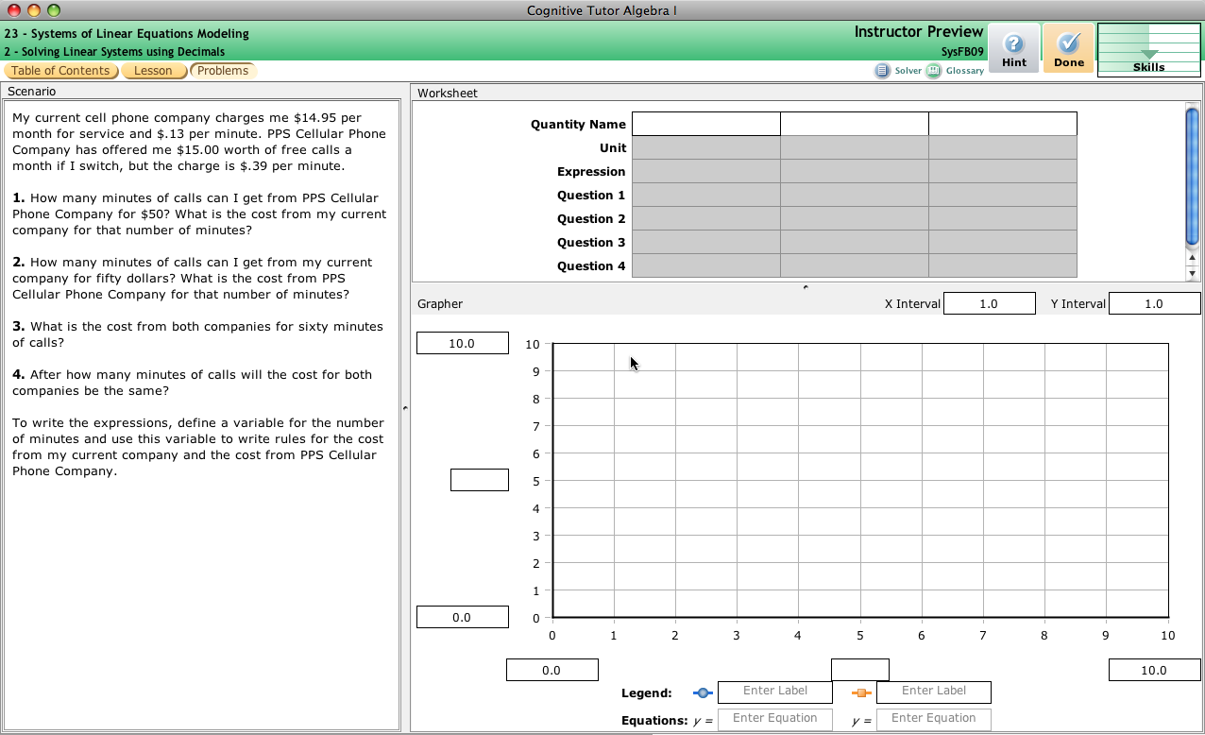
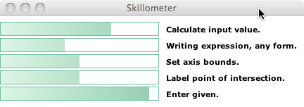
Cognitive Tutors: Adaptive Support for Learning by Doing
Authentic problems
Feedback within complex solutions
Progress…
Personalized instruction
Challenging questions
… individualization
Koedinger et al. (1997). Intelligent tutoring goes to school in the big city. International Journal of Artificial Intelligence in Education,

Slide 14
As Barbara said:
Iterative Engineering is Key

Slide 15
Don’t just apply learning science
Apply learning science

Slide 16
Do Iterative Learning Engineering!
Design explanatory models of learners
Use insights from data to redesign
Contribute use-inspired basic research
Use models to design instruction
… design, deploy, data, discover, design, deploy … [repeat]

Slide 17
Summary
Learning & education are complex
KLI helps simplify
Don’t forget the forgotten middle
Non-verbal skill learning is fundamental
Deliberate practice works!
Ed tech supports deliberate practice
Provides data for improvement

Slide 18
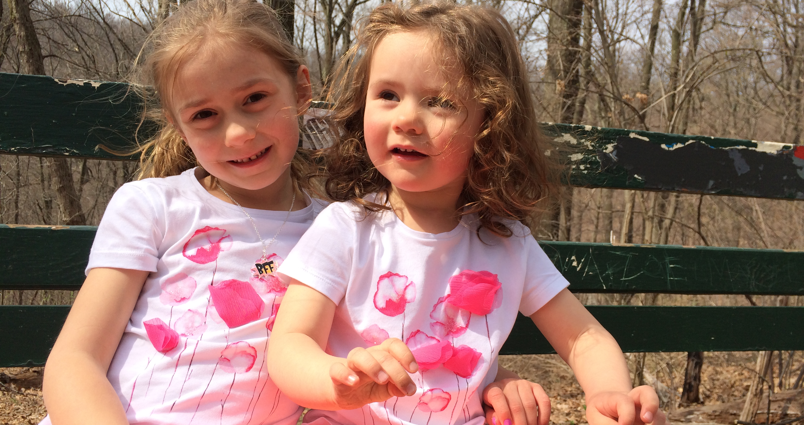
Thank you!
http://learnlab.org
http://cmu.edu/simon
Ken Koedinger
koedinger@cmu.edu
My inspiration (daughters)!

