Slide 1
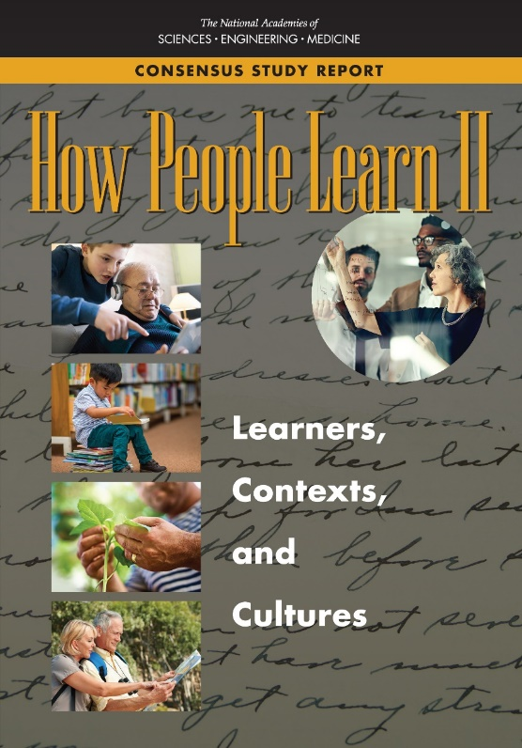
Division of behavioral and social sciences and education

Slide 2
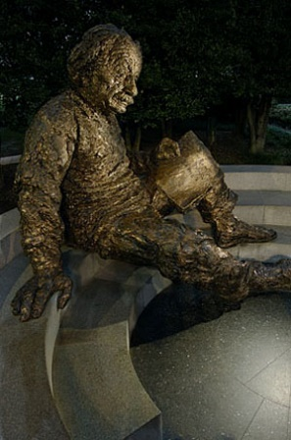
The National Academies
A non-governmental organization (NGO)
Founded in 1863
Bring together committees of experts in all areas of scientific and technological endeavor
Address critical national issues and give advice to the federal government and the nation
NATIONAL ACADEMY OF MEDICINE
Notes:
NAS is not a federal governmental agency
Work based on experts and evidence

Slide 3
Committee Charge
Review and synthesize research on the study of learning from birth through adulthood in both formal and informal settings….with greatest potential to influence practice and policy.
Specify directions for strategic investments in research and development to promote the knowledge, training, and technologies that are needed to support learning in today's world.

Slide 4
Committee Expertise
Cognitive science
Learning theory
Cognitive neuroscience
Educational psychology
Workforce development and adult learning
Education technology

Slide 5
Committee on the Science and Practice of Learning
Cora Bagley Marrett (Chair), Department of Sociology, University of Wisconsin–Madison
Patricia J. Bauer, Department of Psychology, Emory University
Cynthia Beall (NAS), Department of Anthropology, Case Western Reserve
Margaret E. Beier, Department of Psychology, Rice University
David B. Daniel, Department of Psychology, James Madison University
Robert L. Goldstone, Department of Psychological and Brain Sciences, Indiana University
Arthur C. Graesser, Department of Psychology and Institute of Intelligent Systems, Univ. of Memphis
Mary Helen Immordino-Yang, Rossier School of Education, University of Southern California
Ruth Kanfer, School of Psychology, Georgia Institute of Technology
Jeffrey D. Karpicke, Department of Psychological Sciences, Purdue University
Barbara M. Means, Learning Sciences Research, Digital Promise
Douglas L. Medin (NAS), Department of Psychology, Northwestern University
Linda Nathan, Center for Artistry and Scholarship
Annemarie Sullivan Palincsar, School of Education, University of Michigan
Daniel L. Schwartz, School of Education, Stanford University
Zewelanji N. Serpell, Department of Psychology, Virginia Commonwealth University

Slide 6
The report’s conclusions address:
Complex Influences of Culture
Types and Processes of Learning
Knowledge and Reasoning
Motivation to Learn
Implications for Learning in School
Learning Technology
Learning across the Life Span

Slide 7
Complex Influences of Culture
Conclusion 2-1: Each learner develops a unique array of knowledge and cognitive resources in the course of life that are molded by the interplay of that learner’s cultural, social, cognitive, and biological contexts. Understanding the developmental, cultural, contextual, and historical diversity of learners is central to understanding how people learn.
Notes:
Learners function within complex developmental, cognitive, physical, social, and cultural systems. Research and theory from diverse fields have contributed to an evolving understanding that all learners grow and learn in culturally defined ways in culturally defined contexts. While humans share basic brain structures and processes, as well as fundamental experiences such as relationships with family, age-related stages, and many more, each of these phenomena are shaped by an individual’s precise experiences. Learning does not happen in the same way for all people because cultural influences are influential from the beginning of life. These ideas about the intertwining of learning and culture have been reinforced by research on many facets of learning and development.

Slide 8
What is Culture?
Culture is a product of the way individuals learn to coordinate desirable and useful activities with others.
It is expressed in many ways, through:
the actions, expectations, and beliefs of individual persons;
physical elements such as artifacts, tools, and the design of physical spaces;
norms for interacting with others, both verbally and nonverbally; and
beliefs and ways of looking at the world that are shared with others.
Notes:
I want to note that we ALL have culture. Sometimes it gets talked about as only those weird people have culture. When you are a member of the dominant culture your own cultural practices, beliefs, activities can become invisible. You can come to think well, what I do is just the norm and those “other” people are the ones who have culture. In early days of exploration and colonization this is the frame that many Europeans brought to understanding the other people they encountered.
Really struck home to me when I was having a conversation with a colleague from Puerto Rico and mentioned I was organizing a family reunion one summer. He knows I’m a white woman from the Midwest. He said, slightly tongue in cheek, “so, do you guys have jello with marshmallows, and potato salad, and play corn hole and all that?” I had to laugh because, yep, that’s pretty much exactly what we were going to do. He had totally nailed some of our cultural practices.

Slide 9
Key Insights
Cultural influences shape learners from the start of life.
Learning is inherently social
Different cultures place different value on learning by copying/ creating, doing/observing, talking/listening, explaining/acting.
The contexts in which people learn such as school are not culture-free.

Slide 10
Processes of Learning
CONCLUSION 4-1: Successful learning requires coordination of multiple cognitive processes that involve different networks in the brain. In order to coordinate these processes, an individual needs to be able to monitor and regulate her own learning. The ability to monitor and regulate learning changes over the lifespan and can be improved through interventions.

Slide 11
Motivation to Learn
CONCLUSION 6-1: Motivation to learn is influenced by the multiple goals that individuals construct for themselves as a result of their life and school experiences and the sociocultural context in which learning takes place. Motivation to learn is fostered for learners of all ages when they perceive the school or learning environment is a place where they “belong” and when the environment promotes their sense of agency and purpose.
Notes:
Conscious learning requires sustained effort. To learn intentionally, people must want to learn and must see the value in accomplishing what is being asked of them. Numerous factors and circumstances influence an individual’s desire to learn and the decision to expend effort on learning. Engagement and intrinsic motivation develop and change over time; they are not properties of the individual or the environment alone, and they are strongly influenced by cultural and developmental processes.

Slide 12
Learning in School
CONCLUSION 7-1: Effective instruction depends on understanding of:
the complex interplay among learners’ prior knowledge, experiences, motivations, interests, and language and cognitive skills;
educators’ own experiences and cultural influences;
and the cultural, social, cognitive, and emotional characteristics of the learning environment.
Notes:
We highlight four topics related to schooling. First, understanding of the cultural nature of learning and development means that what takes place in every classroom—the learning environment, the influence of educators, and all students’ experience of school—cannot be fully understood without attention to cultural influences. Second, there is a growing body of research that examines learning in academic content areas that can provide guidance to educators. Third, a part of what is accomplished when educators attend to the influences of culture on the classroom environment and the perspectives students bring to their learning is that learners are better supported in taking charge of their own learning. Many strategies for fostering specific types and functions of learning are primarily ways of supporting the learner in actively making progress and improvements for himself. Finally, assessing learning is a central part of education in school and can be informed by understanding how learning occurs.

Slide 13
Learning in School
CONCLUSION 7-2: Research points to the importance of engaging learners in directing their own learning by providing:
guidance as targeted feedback and support in developing metacognitive skills,
challenges that are well matched to the learner’s current capacities, and
support in setting and pursuing meaningful goals.

Slide 14
Learning in School
CONCLUSION 7-3: A growing body of research supports adopting an asset model of education in which curricula and instructional techniques support all learners in connecting academic learning goals to the learning they do outside of school settings and through which learning experiences and opportunities from various settings are leveraged for each learner.

Slide 15
Learning in School
CONCLUSION 7-4: Purposefully teaching the language and practices specific to particular disciplines, such as science, history, and mathematics, is critical to helping students develop deep understanding in these subjects.

Slide 16
Learning in School
CONCLUSION 7-5: Assessment is a critical tool for advancing and monitoring students’ learning in school. When grounded in well-defined models of learning, assessment information can be used to identify and subsequently narrow the gap between current and desired levels of students’ learning and performance.

Slide 17
Sponsors
Alfred P. Sloan Foundation
American Educational Research Association
Bill & Melinda Gates Foundation
Institute of Education Sciences of the U.S. Department of Education
Teagle Foundation
William and Flora Hewlett Foundation
Additional support:
National Academy of Sciences W.K. Kellogg Fund
National Academies of Sciences, Engineering, and Medicine Presidents’ Circle Fund

Slide 18
Report is available at:
www.nap.edu
THANK YOU!
Notes:
Among the topics on which further research is needed are whether a technology is well suited to the ecological learning niche in which it may be used, the effects of engagement in self-selected online activities on academic learning, and ways to improve the suite of learning technologies available.

